Slide 1
Simplicity Favors Regularity
James Tacey

Slide 2
Overview
RISC architecture
Only 1 instruction type
Multicycle
Simplified datapath
2 user-controlled registers

Slide 3
Instruction Architecture
Opcode Reg Dest Address
XXXX X XXXXXXXXXXX
Every instruction accesses memory
Regularity of the instructions allows simplicity in datapath and controller
Not every instruction uses every field

Slide 4
Instructions
Opcode | Instruction | Effect
0000 | ADD REG, ADDRESS | REG + data in ADDRESS -> REG
0001 | SUB REG, ADDRESS | REG - data in ADDRESS -> REG
0010 | AND REG, ADDRESS | REG & data in ADDRESS -> REG
0011 | XOR REG, ADDRESS | REG XOR data in ADDRESS -> REG
0100 | NOT REG | NOT REG -> REG
0101 | SHL REG | SHL REG -> REG
0110 | SHR REG | SHR REG -> REG
0111 | OR REG, ADDRESS | REG|| data in ADDRESS -> REG
1000 | LDR REG, ADDRESS | Load data in ADDRESS into REG
1001 | STR REG, ADDRESS | Store data in REG into ADDRESS
1010 | HLT | Halts processor
1011 | JRR ADDRESS | Jumps to address stored in internal register
1100 | JMP ADDRESS | Unconditional Jump
1101 | JR ADDRESS | Jump and store current address in internal register
1110 | JP REG, ADDRESS | Jump if REG is positive
1111 | JZ REG, ADDRESS | Jump if REG is zero

Slide 5
Process Flow
Fetch
Decode
Memory Access
Execution
Write

Slide 6
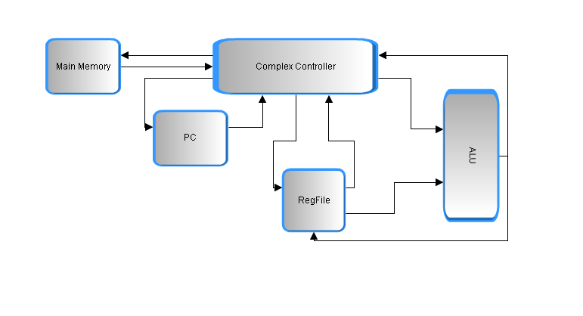
Datapath

Slide 7
Pros and Cons
Pros:
Simple and effective
Only one type of instruction
Many aspects of traditional datapath are integrated into controller
Cons:
Requires memory access for every instruction
Controller design is more complex

Slide 8
Status
Working
Fully simulated and verified as expected
Downloads successfully to board
Problems
Board does not run as expected
In-System Memory Content Editor causes Quartus II to crash
PC does not increment as expected

Slide 9
Questions?

